Slide 1
Chapter 3:Streams Based I/O (input/output), Networking and Serialization

Slide 2
Learning Objectives
Introduction to I/O and Streams
Introduction and Implementation of ByteStream
Character Streams
Buffered Streams
Data Streams and Object Streams
File I/O
Introduction to Network Programming
Introduction to TCP and UDP
Implementation of Socket and InetAddress class
URL in Terms of Java Network Programming
Datagram in network environment
DNS and Reverse DNS Lookup
Serializable in Java
Class Refactoring with Serialization and serialVersionUID
Java Externalizable Interface
Java Serialization Methods
Serialization with Inheritance
Serialization Proxy Pattern

Slide 3
Java.io.File Class in Java
The File class is Java’s representation of a file or directory path name. Because file and directory names have different formats on different platforms, a simple string is not adequate to name them. The File class contains several methods for working with the path name, deleting and renaming files, creating new directories, listing the contents of a directory, and determining several common attributes of files and directories.
It is an abstract representation of file and directory pathnames.
A pathname, whether abstract or in string form can be either absolute or relative. The parent of an abstract pathname may be obtained by invoking the getParent() method of this class.
First of all, we should create the File class object by passing the filename or directory name to it. A file system may implement restrictions to certain operations on the actual file-system object, such as reading, writing, and executing. These restrictions are collectively known as access permissions.
Instances of the File class are immutable; that is, once created, the abstract pathname represented by a File object will never change.

Slide 4
How to create a File object?
A File object is created by passing in a String that represents the name of a file, or a String or another File object.

Slide 5
java.io.File class Constructors
File(File parent, String child) : Creates a new File instance from a parent abstract pathname and a child pathname string.
File(String pathname) : Creates a new File instance by converting the given pathname string into an abstract pathname.
File(String parent, String child) : Creates a new File instance from a parent pathname string and a child pathname string.
File(URI uri) : Creates a new File instance by converting the given file: URI into an abstract pathname.

Slide 6
java.io.File Methods
boolean canExecute() : Tests whether the application can execute the file denoted by this abstract pathname.
boolean canRead() : Tests whether the application can read the file denoted by this abstract pathname.
boolean canWrite() : Tests whether the application can modify the file denoted by this abstract pathname.
int compareTo(File pathname) : Compares two abstract pathnames lexicographically.
boolean createNewFile() : Atomically creates a new, empty file named by this abstract pathname .
static File createTempFile(String prefix, String suffix) : Creates an empty file in the default temporary-file directory.
boolean delete() : Deletes the file or directory denoted by this abstract pathname.
boolean equals(Object obj) : Tests this abstract pathname for equality with the given object.
boolean exists() : Tests whether the file or directory denoted by this abstract pathname exists.
String getAbsolutePath() : Returns the absolute pathname string of this abstract pathname.
long getFreeSpace() : Returns the number of unallocated bytes in the partition .
String getName() : Returns the name of the file or directory denoted by this abstract pathname.
String getParent() : Returns the pathname string of this abstract pathname’s parent.
File getParentFile() : Returns the abstract pathname of this abstract pathname’s parent.
String getPath() : Converts this abstract pathname into a pathname string.
boolean isDirectory() : Tests whether the file denoted by this pathname is a directory.
boolean isFile() : Tests whether the file denoted by this abstract pathname is a normal file.
boolean isHidden() : Tests whether the file named by this abstract pathname is a hidden file.
long length() : Returns the length of the file denoted by this abstract pathname.
String[] list() : Returns an array of strings naming the files and directories in the directory .
File[] listFiles() : Returns an array of abstract pathnames denoting the files in the directory.
boolean mkdir() : Creates the directory named by this abstract pathname.
boolean renameTo(File dest) : Renames the file denoted by this abstract pathname.

Slide 7
java.io.File Methods - continued…
boolean setExecutable(boolean executable) : A convenience method to set the owner’s execute permission.
boolean setReadable(boolean readable) : A convenience method to set the owner’s read permission.
boolean setReadable(boolean readable, boolean ownerOnly) : Sets the owner’s or everybody’s read permission.
boolean setReadOnly() : Marks the file or directory named so that only read operations are allowed.
boolean setWritable(boolean writable) : A convenience method to set the owner’s write permission.
String toString() : Returns the pathname string of this abstract pathname.
URI toURI() : Constructs a file URI that represents this abstract pathname.

Slide 8
Streams
A stream is a sequence of data.In Java a stream is composed of bytes. It's called a stream because it is like a stream of water that continues to flow.
In java, 3 streams are created for us automatically. All these streams are attached with console.
System.out: standard output stream
System.in: standard input stream
System.err: standard error stream

Slide 9
OutputStream
Java application uses an output stream to write data to a destination, it may be a file, an array, peripheral device or socket.

Slide 10
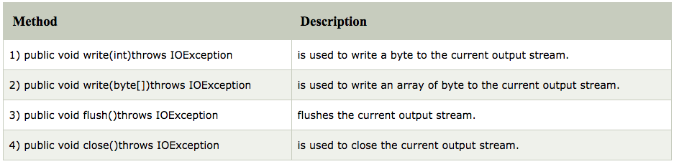
OutputStream Methods

Slide 11
InputStream
InputStream class is an abstract class. It is the super class of all classes representing an input stream of bytes.

Slide 12
InputStream vs OutputStream

Slide 13
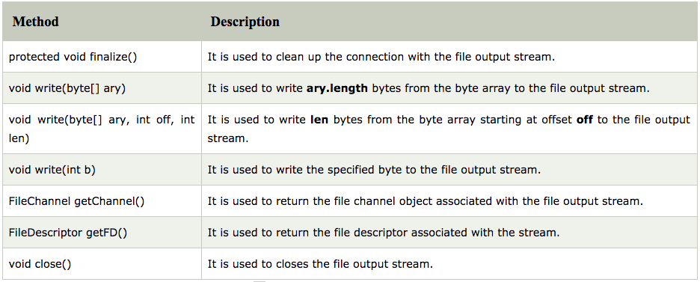
Java FileOutputStream Class
Java FileOutputStream is an output stream used for writing data to a file.
If you have to write primitive values into a file, use FileOutputStream class. You can write byte-oriented as well as character-oriented data through FileOutputStream class. But, for character-oriented data, it is preferred to use FileWriter than FileOutStream.

Slide 14
Java FileInputStream Class
Java FileInputStream class obtains input bytes from a file. It is used for reading byte-oriented data (streams of raw bytes) such as image data, audio, video etc. You can also read character-stream data. But, for reading streams of characters, it is recommended to use FileReader class.

Slide 15
Java BufferedOutputStream Class
Java BufferedOutputStream class is used for buffering an output stream. It internally uses buffer to store data. It adds more efficiency than to write data directly into a stream. So, it makes the performance fast.
For adding the buffer in an OutputStream, use the BufferedOutputStream class.

Slide 16
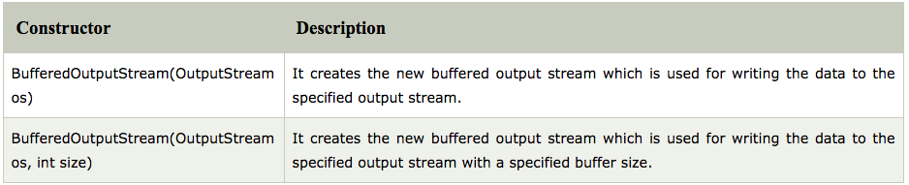
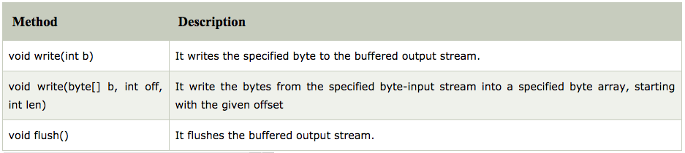
Java BufferedOutputStream Class

Slide 17
Java BufferedInputStream Class
Java BufferedInputStream class is used to read information from stream. It internally uses buffer mechanism to make the performance fast.
The important points about BufferedInputStream are:
When the bytes from the stream are skipped or read, the internal buffer automatically refilled from the contained input stream, many bytes at a time.
When a BufferedInputStream is created, an internal buffer array is created.

Slide 18
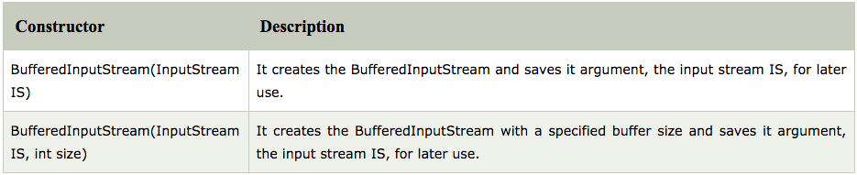
Java BufferedInputStream Class

Slide 19
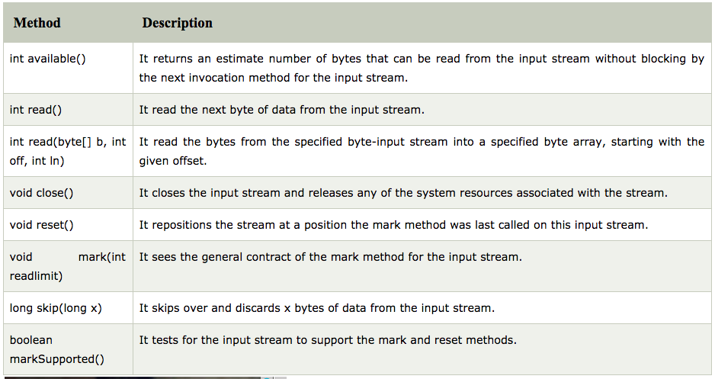
Java BufferedInputStream Class

Slide 20
Java FileWriter Class
Java FileWriter class is used to write character-oriented data to a file. It is character-oriented class which is used for file handling in java.
Unlike FileOutputStream class, you don't need to convert string into byte array because it provides method to write string directly.

Slide 21
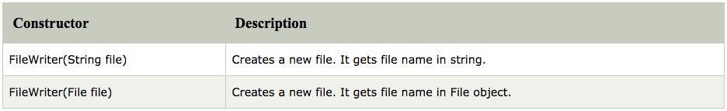
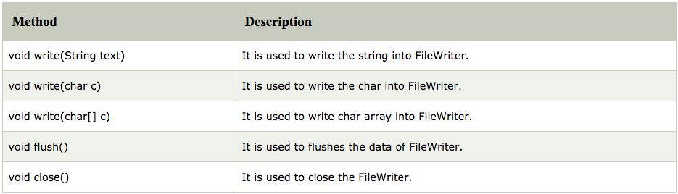
Java FileWriter Class

Slide 22
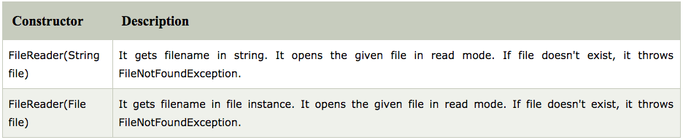
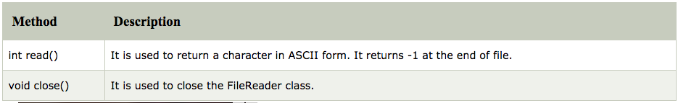
Java FileReader Class
Java FileReader class is used to read data from the file. It returns data in byte format like FileInputStream class.
It is character-oriented class which is used for file handling in java.

Slide 23
Other I/O Classes
SequenceInputStream
ByteArrayOutputStream
ByteArrayInputStream
DataOutputStream
DataInputStream
Console
FilePermission
Java FilteroutputStream
Java FilterInputStream
**Refer to Java Documentation for Details

Slide 24
Other I/O classes
BufferedWriter
BufferedReader
CharArrayReader
CharArrayWriter
PrintStream
PrintWriter
PushbackInputStream
PushbackReader
StringWriter
StringReader
**Refer to Java Documentation for Details

Slide 25
Examples: Chapter 3
See COREJ2-Chapter3 at https://github.com/CompleteJavaTraining/JavaEssentials/tree/master/Code/COREJ2-Chapter3

Slide 26
Java Network Programming
The term network programming refers to writing programs that execute across multiple devices (computers), in which the devices are all connected to each other using a network.
The java.net package of the J2SE APIs contains a collection of classes and interfaces that provide the low-level communication details, allowing you to write programs that focus on solving the problem at hand.
The java.net package provides support for the two common network protocols:
TCP − TCP stands for Transmission Control Protocol, which allows for reliable communication between two applications. TCP is typically used over the Internet Protocol, which is referred to as TCP/IP.
UDP − UDP stands for User Datagram Protocol, a connection-less protocol that allows for packets of data to be transmitted between applications.

Slide 27
Introduction to TCP and UDP

Slide 28
TCP Example
TCP Server communication model
TCP Client
communication model
TCP client/server communication flow

Slide 29
UDP Example
UDP Server communication model
UDP Client
communication model
UDP client/server communication flow

Slide 30
Sockets
Sockets provide the communication mechanism between two computers using TCP. A client program creates a socket on its end of the communication and attempts to connect that socket to a server.
When the connection is made, the server creates a socket object on its end of the communication. The client and the server can now communicate by writing to and reading from the socket.
The java.net.Socket class represents a socket, and the java.net.ServerSocket class provides a mechanism for the server program to listen for clients and establish connections with them.
The following steps occur when establishing a TCP connection between two computers using sockets −The server instantiates a ServerSocket object, denoting which port number communication is to occur on.
The server invokes the accept() method of the ServerSocket class. This method waits until a client connects to the server on the given port.
After the server is waiting, a client instantiates a Socket object, specifying the server name and the port number to connect to.
The constructor of the Socket class attempts to connect the client to the specified server and the port number. If communication is established, the client now has a Socket object capable of communicating with the server.
On the server side, the accept() method returns a reference to a new socket on the server that is connected to the client's socket.
After the connections are established, communication can occur using I/O streams. Each socket has both an OutputStream and an InputStream. The client's OutputStream is connected to the server's InputStream, and the client's InputStream is connected to the server's OutputStream.
TCP is a two-way communication protocol, hence data can be sent across both streams at the same time.

Slide 31
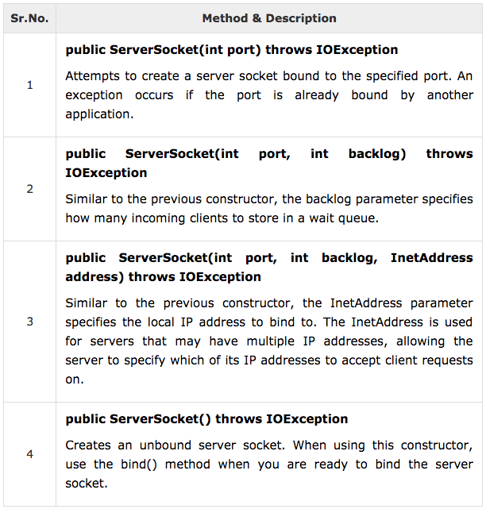
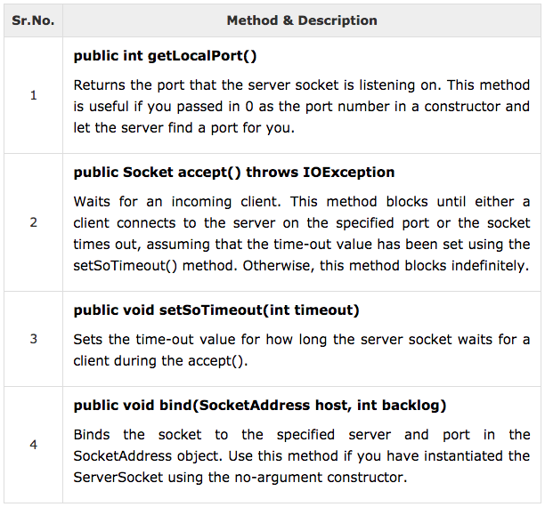
ServerSocket Class
The java.net.ServerSocket class is used by server applications to obtain a port and listen for client requests.

Slide 32
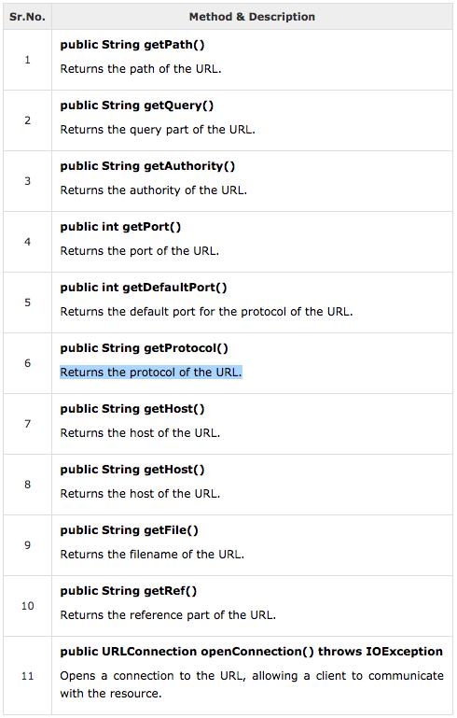
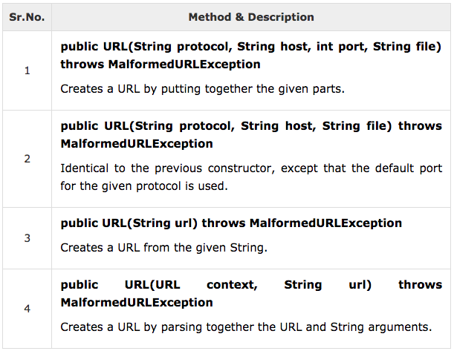
URL in Terms of Java Network Programming
URL stands for Uniform Resource Locator and represents a resource on the World Wide Web, such as a Web page or FTP directory.
URL Class: The java.net.URL class represents a URL and has a complete set of methods to manipulate URL in Java.

Slide 33
Datagram in network environment
Some applications that you write to communicate over the network will not require the reliable, point-to-point channel provided by TCP. Rather, your applications might benefit from a mode of communication that delivers independent packages of information whose arrival and order of arrival are not guaranteed.The UDP protocol provides a mode of network communication whereby applications send packets of data, called datagrams, to one another. A datagram is an independent, self-contained message sent over the network whose arrival, arrival time, and content are not guaranteed. The DatagramPacket and DatagramSocket classes in the java.net package implement system-independent datagram communication using UDP.
What Is a Datagram?
A datagram is an independent, self-contained message sent over the network whose arrival, arrival time, and content are not guaranteed.
The java.net package contains three classes to help you write Java programs that use datagrams to send and receive packets over the network: DatagramSocket, DatagramPacket, and MulticastSocketAn application can send and receive DatagramPackets through a DatagramSocket. In addition, DatagramPackets can be broadcast to multiple recipients all listening to a MulticastSocket.
Applications that communicate via datagrams send and receive completely independent packets of information. These clients and servers do not have and do not need a dedicated point-to-point channel. The delivery of datagrams to their destinations is not guaranteed. Nor is the order of their arrival.

Slide 34
DNS and Reverse DNS Lookup
Domain Name System (DNS) is a hierarchical naming system for computers, services or any resources connected to the internet or a private network.
It translates meaningful domain names to IP Addresses. An often-analogy to explain the Domain Name System is that it serves as phone-book for the internet by translating human-friendly computer hostname into IP Addresses.
The InetAddress class provides methods to resolve hostname to IP Address and vice-versa also (Reverse DNS).
Here are some important methods of InetAddress class:
getAddress: Returns the raw IP Address for this object.
getAllByName(String host): Given the name of host, an array of IP address is returned.
getByAddress(byte[] addr): Returns an InetAddress object given the raw IP address.
getByAddress(String host, byte[] addr): Create an InetAddress based on the provided host name and IP.
addressgetByName(String host): Determines the IP address of a host, given the host's name.
getCanonicalHostName(): Gets the fully qualified domain name for this IP address.
getHostAddress(): Returns the IP address string in textual presentation.
getHostName(): Gets the host name for this IP address.
getLocalHost(): Returns the local host.

Slide 35
Examples: Chapter 3
See COREJ2-Chapter3 at https://github.com/CompleteJavaTraining/JavaEssentials/tree/master/Code/COREJ2-Chapter3

Slide 36
Serialization in Java
Serialization in java is a mechanism of writing the state of an object into a byte stream.
It is mainly used in Hibernate, RMI, JPA, EJB and JMS technologies.
The reverse operation of serialization is called deserialization.
It is mainly used to travel object's state on the network (known as marshaling).

Slide 37
Deserialization in java
Deserialization is the process of reconstructing the object from the serialized state.It is the reverse operation of serialization.

Slide 38
java.io.Serializable interface
Serializable is a marker interface (has no data member and method). It is used to "mark" java classes so that objects of these classes may get certain capability. The Cloneable and Remote are also marker interfaces.
It must be implemented by the class whose object you want to persist.
The String class and all the wrapper classes implements java.io.Serializable interface by default.

Slide 39
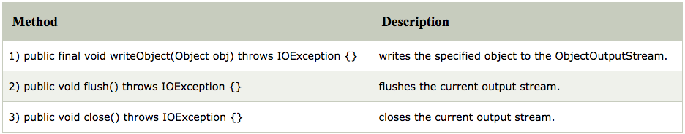
ObjectOutputStream class
The ObjectOutputStream class is used to write primitive data types and Java objects to an OutputStream. Only objects that support the java.io.Serializable interface can be written to streams.
public ObjectOutputStream(OutputStream out) throws IOException {}creates an ObjectOutputStream that writes to the specified OutputStream.

Slide 40
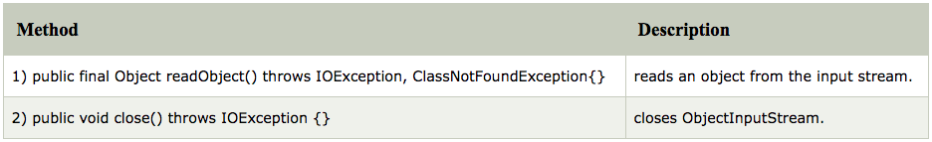
ObjectInputStream class
An ObjectInputStream deserializes objects and primitive data written using an ObjectOutputStream.
public ObjectInputStream(InputStream in) throws IOException {}: creates an ObjectInputStream that reads from the specified InputStream.

Slide 41
Some facts
If a class implements serializable then all its sub classes will also be serializable.
If a class has a reference of another class, all the references must be Serializable otherwise serialization process will not be performed. In such case, NotSerializableException is thrown at runtime.
If there is any static data member in a class, it will not be serialized because static is the part of class not object.
In case of array or collection, all the objects of array or collection must be serializable. If any object is not serialiizable, serialization will be failed.
The Externalizable interface provides the facility of writing the state of an object into a byte stream in compress format. It is not a marker interface. The Externalizable interface provides two methods:
public void writeExternal(ObjectOutput out) throws IOException
public void readExternal(ObjectInput in) throws IOException
If you don't want to serialize any data member of a class, you can mark it as transient.

Slide 42
Examples: Chapter 3
See COREJ1-Chapter3 at https://github.com/CompleteJavaTraining/JavaEssentials/tree/master/Code/COREJ1-Chapter3

Slide 43
What are we learning in Next Chapter ?
You will learn about Collections
We will learn about:
Collections Overview
Collection Types, Arrays
Sets
Sequence
Maps
Understanding Hashes and Hash Generation
ArrayList and Vectors

Slide 44
Thank You !

